Slide 1
Middle School Performance Expectations in Evolution
MS-LS4-2. Apply scientific ideas to construct an explanation for the anatomical similarities and differences among modern organisms and between modern and fossil organisms to infer evolutionary relationships.
High School Performance Expectations in Evolution
HS-LS4-1. Communicate scientific information that common ancestry and biological evolution are supported by multiple lines of empirical evidence.
Clarification Statement: Emphasis is on a conceptual understanding of the role each line of evidence has in relation to common ancestry and biological evolution. Examples of evidence could include similarities in DNA sequences, anatomical structures, and order of appearance of structures in embryological development.

Slide 2
Taxon B is more closely related to . . .
Taxon A
Taxon D

Slide 3
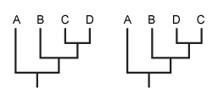
MISCONCEPTION: Taxa that are adjacent on the tips of phylogeny are more closely related to one another than they are to taxa on more distant tips of the phylogeny.
Correction: In a phylogeny, information about relatedness is portrayed by the pattern of branching, not by the order of taxa at the tips of the tree.
Are the two trees below the same?
A. Yes
B. No

Slide 4
Taxon B shared a common ancestor more recently with . . .
Taxon A
Taxon D

Slide 5
MISCONCEPTION: Taxa that are adjacent on the tips of phylogeny are more closely related to one another than they are to taxa on more distant tips of the phylogeny.
Correction: Organisms that share a more recent branching point (i.e., a more recent common ancestor) are more closely related than are organisms connected by a more ancient branching point (i.e., one that is closer to the root of the tree).

Slide 6
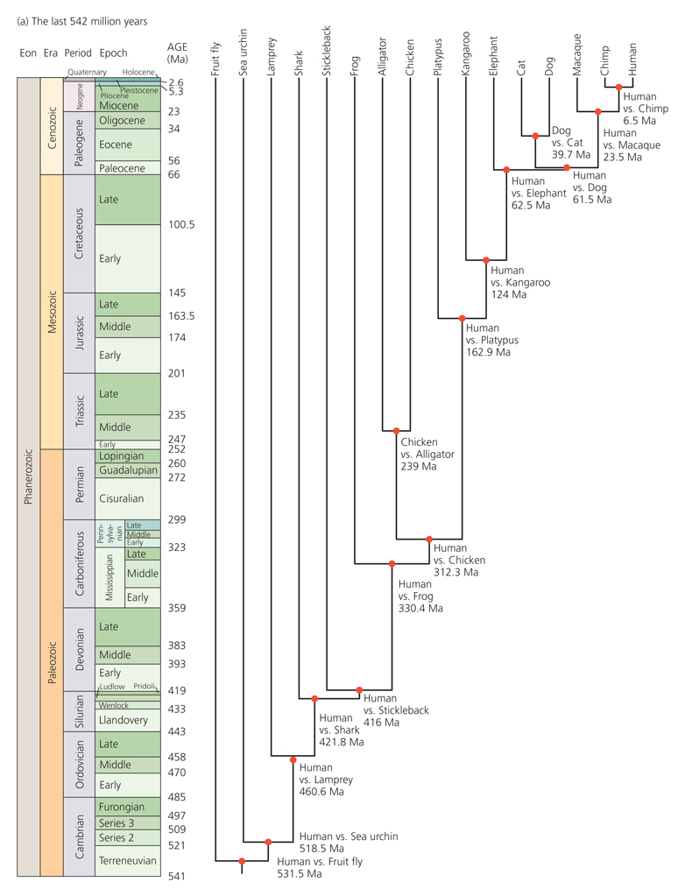
True or False: Alligators are more closely related to humans than they are to frogs.
A. True
B. False

Slide 7
Are salmon more closely related to lampreys or to humans?
Lungfish
Lizard
lampreys
salmon
Human
A. Lampreys
B. Humans

Slide 8
Misconception probe: Which taxon is the most advanced?
Taxon A
Taxon B
Taxon C
Taxon D
Not an appropriate question

Slide 9
MISCONCEPTION: Taxa that appear near the right-hand side of a phylogeny are more advanced than other organisms on the tree.
CORRECTION: This misconception encompasses two distinct misunderstandings. First, when it comes to evolution, terms like "primitive" and "advanced" don't apply. These are value judgments that have no place in science. One form of a trait may be ancestral to another more derived form, but to say that one is primitive and the other advanced implies that evolution entails progress — which is not the case.
Second, the same set of relationships can be portrayed in many different ways.

Slide 10
Lampreys
Teleosts
Lungfish
Salamander
Sharks
Alligator
Doves
Humans

Slide 11
In Ichthyology, I almost always draw humans in the middle.
Alligator
Doves
Humans
Salamanders
Lampreys
Lungfish
Sharks
Teleosts

Slide 12
Maintaining the same patterns of relatedness, draw the ‘doves’ on the right.
Maintaining the same patterns of relatedness, draw the geckos on the right. Can you also put the anoles next to the geckos and maintain the same pattern of relatedness?

Slide 13
Do these two trees show the same evolutionary pattern?
A. Yes
B. No

Slide 14
Misconception probe: Which taxon represents the ancestor of the clade containing C+D?
Taxon A
Taxon B
Taxon C
Taxon D
None

Slide 15
Are modern day sharks the ancestors to modern day lungfish?

Slide 16
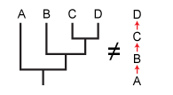
MISCONCEPTION: Taxa that are nearer the left-hand side of a phylogeny represent the ancestors of the other organisms on the tree.
CORRECTION: On phylogenies, ancestral forms are represented by branches and branching points, not by the tips of the tree. The tips of the tree (wherever they are located) represent descendants, and the tree itself represents the relationships among these descendants. In the phylogeny below, taxon A is the cousin of taxa B, C, and D — not their ancestor.
Ancestor 2
Ancestor 1
Ancestor 3

Slide 17
Which group represents the most recent common ancestor of the clade containing C+D?
Taxon B
Ancestor 1
Ancestor 2
Ancestor 3

Slide 18
MISCONCEPTION: Taxa that are nearer the left-hand side of a phylogeny represent the ancestors of the other organisms on the tree.
CORRECTION: On phylogenies, ancestral forms are represented by branches and branching points, not by the tips of the tree. The tips of the tree (wherever they are located — top, bottom, right, or left) represent descendents, and the tree itself represents the relationships among these descendents. In the phylogeny below, taxon A is the cousin of taxa B, C, and D — not their ancestor.
Which arrow represents time?
A.
B.

Slide 19
MISCONCEPTION: Taxa that are nearer the left-hand side of a phylogeny represent the ancestors of the other organisms on the tree.
CORRECTION: On phylogenies, ancestral forms are represented by branches and branching points, not by the tips of the tree. The tips of the tree (wherever they are located — top, bottom, right, or left) represent descendents, and the tree itself represents the relationships among these descendents. In the phylogeny below, taxon A is the cousin of taxa B, C, and D — not their ancestor.
Which arrow represents time?
A.
A
B
B.
C
D

Slide 20
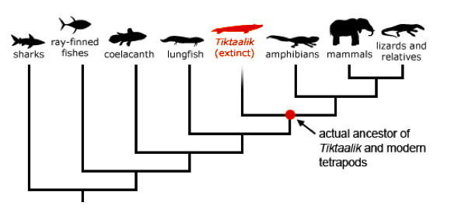
Things can get a bit tricky when you show extinct taxa on the tree.

Slide 21
Misconception Probe: Which taxon is the oldest?
Taxon A
Taxon B
Taxon C
Taxon D
None

Slide 22
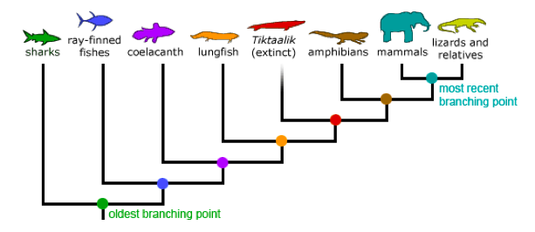
MISCONCEPTION: Taxa that are nearer the left-hand side of a phylogeny evolved earlier than other taxa on the tree.
Correction: 1. You can flip these trees around and maintain the same relationships among the taxa. You could put the shark on the right.
While the lineage leading to sharks did diverge first from the rest of the group, sharks kept evolving.

